Slide 1

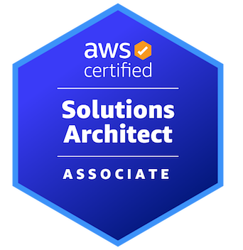

AWS CERTIFIED SOLUTIONS ARCHITECT - ASSOCIATE
Course Introduction
AMBER ISRAELSEN
Developer | Technical Trainer
Notes:
m1-01 = “Why This Course?”
Hi friends, and welcome to this course, AWS Certified Solutions Architect, the Associate level. I’m Amber Israelsen, and I’ll be your guide.

Slide 2

Notes:
A few months ago, I was visiting family, and was watching my little nephew playing with his building blocks. He seemed very thoughtful and precise in his skills, like his whole little world depended on doing it right.

Slide 3
“What do you want to be when you grow up?”
Notes:
After observing for a while, I asked him: “what do you want to be when you grow up?”

Slide 4
“An architect.”
Notes:
He grinned and said, “an architect!”

Slide 5
“Don’t you mean an AWS Solutions Architect?”
Notes:
To which I responded: “Don’t you mean an AWS Solutions Architect”?

Slide 6
Just kidding!
Notes:
No, I’m just kidding. I didn’t ask that. That would be ridiculous!
And I’m pretty sure no kid in the world says, “I want to be an AWS Solutions Architect when I grow up.” But let me briefly make the case for why that would actually be a great idea—for you AND my nephew.

Slide 7
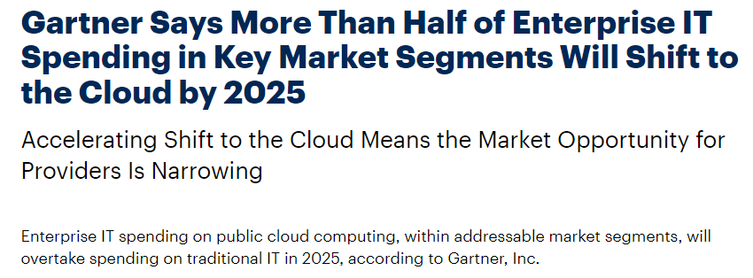
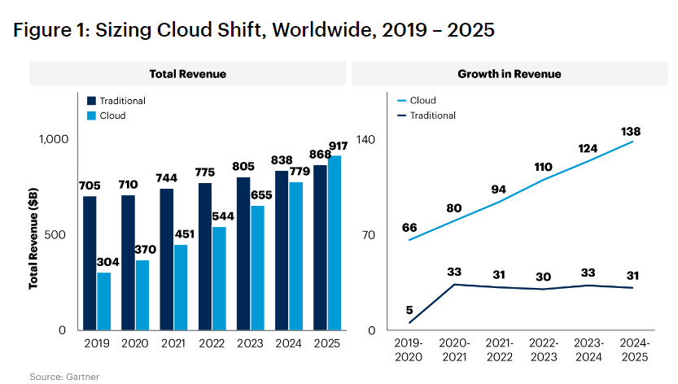
Notes:
If you haven’t heard, cloud computing is here to stay, and it’s growing every year.
Gartner forecasts more than half of enterprise IT spend shifting to the cloud by 2025. That’s huge. And you’ll see the steady pattern there on the graph.
https://www.gartner.com/en/newsroom/press-releases/2022-02-09-gartner-says-more-than-half-of-enterprise-it-spending

Slide 8
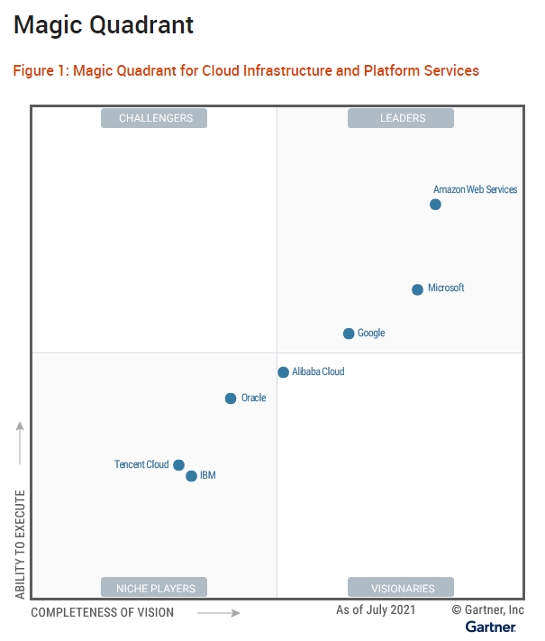
Notes:
And also according to Gartner, in their Magic Quadrant publication, AWS has a sizeable lead over the closest competitors of Microsoft and Google. So really a great space to be in now and for the foreseeable future.
https://www.gartner.com/doc/reprints?id=1-271OE4VR&ct=210802&st=sb

Slide 9
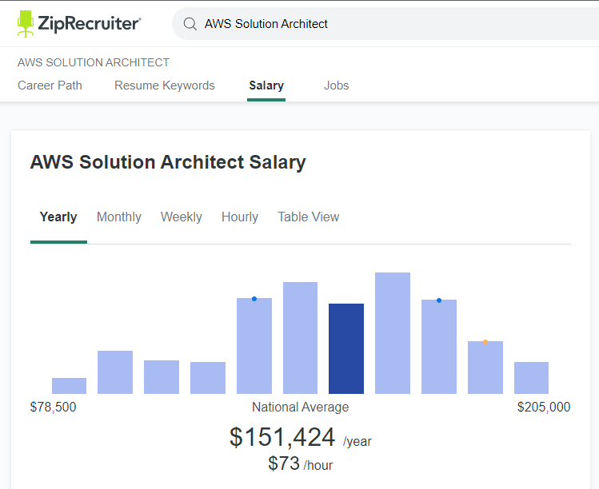
Notes:
And according to ZipRecruiter.com, the average salary for an AWS Solutions Architect is just about $150,000 USD per year. Not too shabby!
https://www.ziprecruiter.com/Salaries/AWS-Solution-Architect-Salary

Slide 10
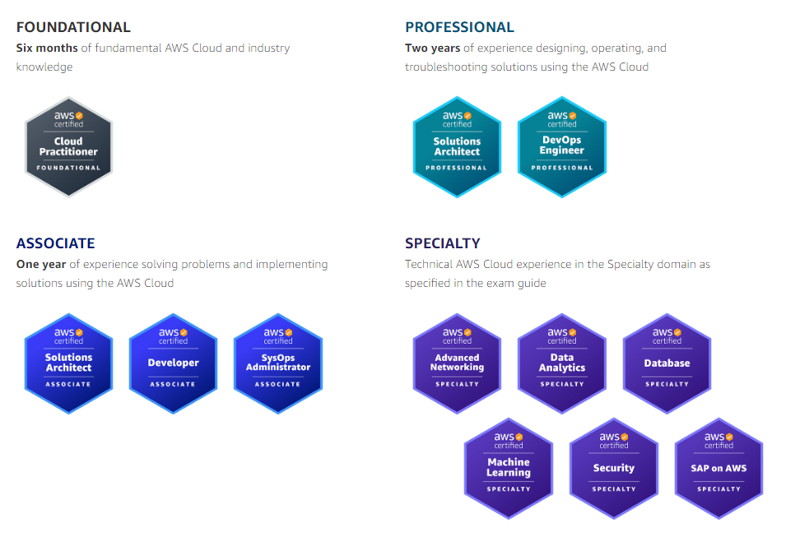
Notes:
So it’s a good thing you’re here!
Getting an AWS certification is one of the best ways to learn AWS and prove that you’re serious about the role. In the big picture (click), this is the certification we’re focused on, the Associate level, which builds on the Cloud Practitioner Foundational cert.

Slide 11
Notes:
As we go, we’ll talk more about what this certificate entails and how it differs from Cloud Practitioner, but I’ll just say up front that it’s a great way to open doors and validate that you have what it takes.

Slide 12
DEMO
Overviewing the AWS Certification Path and Exam Guide
Notes:
m1-02 = “Where This Fits into the AWS Certification Path”
AWS offers a lot of different certifications, so let’s spend just a minute here talking about the certification path and where this one fits in.
For foundational skills, you’ll want to have the Cloud Practitioner certification, or at least that knowledge or experience, under your belt already. While this isn’t enforced by the certification system when you go to take the Architect exam, it’s highly recommended.
And then there are different levels of certification—associate, professional and specialty. And within those, there are certifications aimed at different roles. We’re focused on the Solutions Architect one in this course.
And if you go to the official Exam Guide for this certification (open)
https://d1.awsstatic.com/training-and-certification/docs-sa-assoc/AWS-Certified-Solutions-Architect-Associate_Exam-Guide.pdf
…you’ll see what to expect. Namely, the three bullets on the top here.
Again, talking about what you should know already, it’s recommended that you have 1 year of hands-on AWS experience designing clout solutions in AWS. This 1 year is not a hard requirement either, but it’s a good guideline so you have some frame of reference for how everything fits together, which is a big part of a solution architect’s job.
If we scroll down to the exam Domains, you’ll see there are four of them, and it shows the percentage of the exam for each. And under that, lots of bullets with more details. And then what I find really helpful is actually the Appendix, which lists the different tools and technologies that might appear on the exam, and we’ll be covering all of these in this course.

Slide 13
How is this different than the Cloud Practitioner certification?
Notes:
And if you HAVE taken the Cloud Practitioner certification exam, you might notice that a lot of the technologies listed here were also covered there. So how is this different?
Let’s see a quick analogy for city planning…

Slide 14

DynamoDB database
S3 bucket
EC2 instances
VPC
Notes:
With cloud practitioner, you’re learning about the different parts and pieces that make up the world of AWS. So you know the basics of S3 and EC2 instances, you can set up a virtual private cloud or VPC, and maybe a database like DynamoDB.
With the architecture certification, the focus is more about how these things work together in a way that’s resilient, high-performing and secure—and while optimizing for costs.

Slide 15
Industrial area
DynamoDB database
S3 bucket
EC2 instances
??
VPC
Security boundary
Notes:
So going with our city analogy, it’s figuring out where (click) your security boundaries are—maybe this river around the city. Or saying this whole section of town is just for industrial uses—or in AWS land, maybe this means you’re choosing different regions or availability zones for failover and disaster recovery. Maybe that river floods and a data center goes down.
How are you going to connect your EC2 instances and an S3 bucket (click)? What street or road is that? How (click) about to the database? Which (click) resources go in which VPC, and should they be in public or private subnets? How do you connect an on-premises data center to AWS in a secure way?
And so on. Hopefully that analogy makes sense. So even though we’ll be covering a lot of the same technologies that were in Cloud Practitioner, this course and exam are really about putting the pieces together and implementing best practices from the Well-Architected Framework, which we’ll talk about later in the course as well.

Slide 16
Notes:
Or, to go back to the story of my nephew, it’s taking the building blocks and putting them together.

Slide 17
Course Outline (Part 1)
Course Introduction
AWS Cloud Practitioner Refresher
Authentication and Authorization – Identity and Access Management (IAM)
Compute
Elastic Load Balancing and Auto Scaling
Networking
Storage
Databases
Data Migration and Transfer
Analytics
Notes:
m1-03 = “Course Outline”
Now let’s go through a brief outline of the course and what you can expect to learn.
This course is organized into chapters or modules, and you’ll see the first roughly half here (more on the next slide). We’re starting with the first module, Course Introduction.
Then we’ll spend just a few minutes doing a refresher of from Cloud Practitioner. If you’re feeling pretty comfortable with all of those concepts, feel free to skip that module, but for anybody who’s feeling a little rusty, I wanted to just do a quick baseline to make sure we’re all starting from the same place.
Then we’ll get into authentication and authorization—with Identity and Access Managment (or IAM) being the main focus there.
The Compute module will cover things like EC2, Lambda, Elastic Beanstalk and containers.
Then we’ll get into elastic load balancing and auto scaling, to help with high availability and scaling.
The Networking module will be pretty extensive, covering things like how IP addressing works in AWS, subnets, internet gateways, route tables, security groups, NACLs, NAT gateways, VPC peering and a whole lot more.
For Storage, we’ll spend a fair amount of time on S3, including things like encryption, logging and lifecycle management. We’ll also talk about the Elastic Block Store or EBS, Elastic Filesystem, or EFS, Storage Gateway and the Snow family of products.
For Databases, we’ll cover the Relational Database Service, RDS, Redshift, DynamoDB, Aurora, Elasticache and Glue.
And then in the following module, we’ll talk about how to get your data migrated or transferred, and the various services available to help there.
We’ve got a module dedicated to Analytics—so things like Athena, Kinesis, QuickSight and Elastic Map Reduce or EMR.

Slide 18
Course Outline (Part 2)
Monitoring
Security and Compliance
Automation and Governance
DNS and Network Routing
Application Integration
Machine Learning
Backup and Recovery
Billing and Pricing
The Well-Architected Framework
Preparing for the Exam
Notes:
But wait, there’s more!
We have a whole module about monitoring, so deep-diving on services like CloudWatch and CloudTrail.
Then we move on to cover security and compliance. We’ll revisit the Shared Responsibility Model, and touch on services like AWS Shield, Web Application Firewall, Key Management System, or KMS, and Secrets Manager, just to name a few.
Automation and governance will cover things like CloudFormation, Service Catalog, Systems Manager and AWS Config.
Then we have a module dedicated to DNS and Network Routing. We’ll get into details of the domain name system, then move to Route 53 and CloudFront.
Application integration will cover API Gateway, the Simple Queue Service (SQS) and Simple Notification Service (SNS), along with some others.
Machine learning is a whole huge topic itself. For the Architect certification, you aren’t going to need to know the details, but you will need to know at a high level what some of the services do—services like Rekognition, Comprehend and Texttract, for example.
Backup and recovery will touch on the AWS Backup service, but also focuses on concepts and strategies for disaster recovery.
Billing and pricing—here, we’ll touch on different pricing models for EC2, networking and storage. And we’ll also work with organizations, accounts and Control Tower, as well as Cost Explorer.
And then we have a module about the Well-Architected Framework that should hopefully tie things together. And there, we’ll cover its six core pillars.
And at the end of the course, I’ve included a module about preparing to actually take the exam. This includes things like study strategies and tips, how to actually register for the exam, what to expect day-of and so on. So let’s get started.

Slide 19
DEMO
Creating an AWS Account for Labs
Notes:
m1-04 = “DEMO: Creating an AWS Account for Labs”
Now, one of the VERY best ways to learn AWS—or anything else for that matter—is to just dig in and get some hands-on experience. And you can do that by following along with the plethora of demos I’ll be doing throughout the course. For that, you’re going to need an AWS account. It’s free and easy to set up. Let me show you how…
Switch to the console aws.amazon.com/free
Now, I mentioned a second ago that it’s free to create an account, but you WILL need a valid credit card for identity verification, and you also need a phone that you can receive texts or calls on.
In Incognito window: https://aws.amazon.com/
Show Free Tier: aws.amazon.com/free
Before you enter your CC info, you’ll receive an email letting you know the account has been created. However, you can’t actually use the account until you verify your identity and enter your credit card information here. Note that you WILL be charged $1 (check this on the screen) so Amazon can ensure that it’s a valid card. This will likely show as a pending charge on your credit card for a few days, and then it’ll be removed. Amazon also uses this card for any charges you incur that go beyond the Free Tier.
There are three different support plans available—and you’ll see the basic differences called out here, primarily around pricing and the level of support you get. I’m going to choose the Basic Plan, which is free, and I’ll assume that most of you watching also want that.
After you select that, it’ll activate your account. This usually only takes a few minutes, but can sometimes take up to 24 hours. You’ll receive an email once that’s complete. You CAN sign in to the AWS Console during this period that you’re waiting for the account to be activated, but you might continue to receive a message prompting you to activate your account. So it’s usually best to just wait until you get that email letting you know your account is active.

Slide 20
DEMO
Creating an AWS Budget for Labs
Notes:
m1-05 = “DEMO: Creating an AWS Budget for Labs”
Setup: LOG IN AS ROOT USER
Now that you have your account set up, let’s take just a few minutes to set up an AWS Budget, which will alert you if your spend goes over a certain amount. For the most part, we’ll be using the Free Tier in this course, and I’ll call out where there are costs associated. But it never hurts to have a Budget, just in case you forget to turn something off or delete it. It’s saved my life—and bank account--more than a few times!
You can get here from the Billing Dashboard or you can just type in Budgets (you DO need to be logged in as the root user to do this).
Let’s get started by Creating a budget.
You can create budgets for more than just cost—you can also do budgets around usage, savings plans or reservations. But most common is probably cost, and that’s what we’re going to choose.
Name: Training Account $20 Per Month
Monthly
Recurring
Fixed
$20
And then if you want, you can filter by specific services. Add filter→service→Elastic Cloud Compute→apply. Go back to Add new filter. You can also filters for region, usage type, availability zones and a lot more.
But for my little account here, I’m actually just going to include everything so I’ll remove all my filters. But that’s how you’d add them.
Budget name: Training Account $20 Per Month
Next, Next
Alerts – Add an alert threshold
80% of budgeted amount, trigger Actual (also note forecasted option)
Add email
You can also use Amazon Simple Notification Service (SNS) or Chatbot alerts to receive the notification
(Actions are optional, but you could do something like shut down an EC2 instance if you’re over budget, for example)
Create
So there you go! That’s how to set up a budget and notifications to avoid any surprise bills. And you can just leave that budget in place throughout this course, and even after if you’d like. There are no costs associated with the budget itself, so it’s fine to just leave it there.

